Slide 1
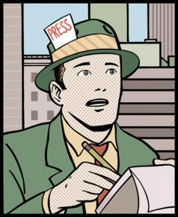
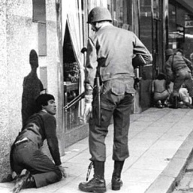
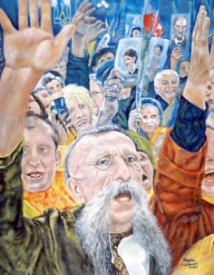
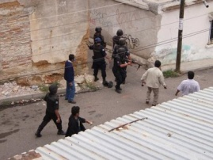
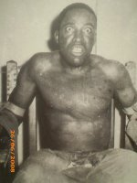
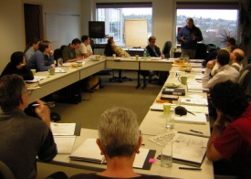
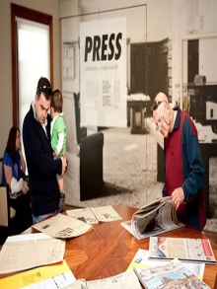
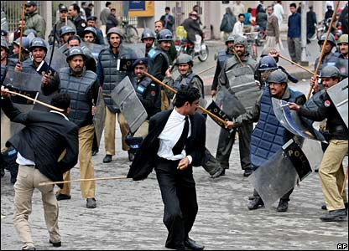
Democracy Dictatorship
A political system for choosing
and replacing the government
through free and fair elections.
The active participation of
the people, as citizens,
in politics and civic life.
Protection of the human
rights of all citizens.
A rule of law, in which the
laws and procedures apply
equally to all citizens.
Is an absolute ruler of a sovereign state;
2. Governs outside the otherwise accepted rule of law
Commonly (but not necessarily) gained power through fraud or a coup d'état, or resorts to them to stay in power
May develop a cult of personality
5. May be autocratic, oppressive, despotic or tyrannical.
5. In a democracy, the people are
sovereign—they are the highest
form of political authority.
6. You have not the right to associate
with other people, and to form and
join organizations of your own choice,
including trade unions.
6. The people are free to criticize their elected
leaders and representatives, and to observe
how they conduct the business of government.
7. You have not the right to assemble freely, and to protest government actions.
7. The key role of citizens in a democracy is
to participate in public life.
8. Torture and cruel and inhumane treatment
are accepted.
8. You have the right to have your own beliefs,
and to say and write what you think.
There is freedom and pluralism in the mass
media.
9. Everyone one may be arrested, imprisoned, or exiled arbitrarily.
No one may be arrested, imprisoned, or exiled
arbitrarily.
10. Government is not based on the consent of the governed.

